Slide 1

Bangladesh Army University of Engineering & Technology Department of Electrical & Electronic Engineering
Lecture: 16
Course Code: EEE 1261
Course Title: Electronic Devices and Circuits
Course Teacher: Ferdous Farjana
Designation: Lecturer, Dept. of EEE, BAUET

Slide 2
Outline
Zener Diode
How does a Zener Diode work in reverse bias?
Avalanche Breakdown in Zener Diode
Zener Breakdown in Zener Diode
Avalanche Breakdown vs. Zener Breakdown
Circuit Symbol of Zener Diode
V-I Characteristics of Zener Diode
Forward Characteristics of Zener Diode
Reverse Characteristics of Zener Diode
Applications of Zener Diode

Slide 3
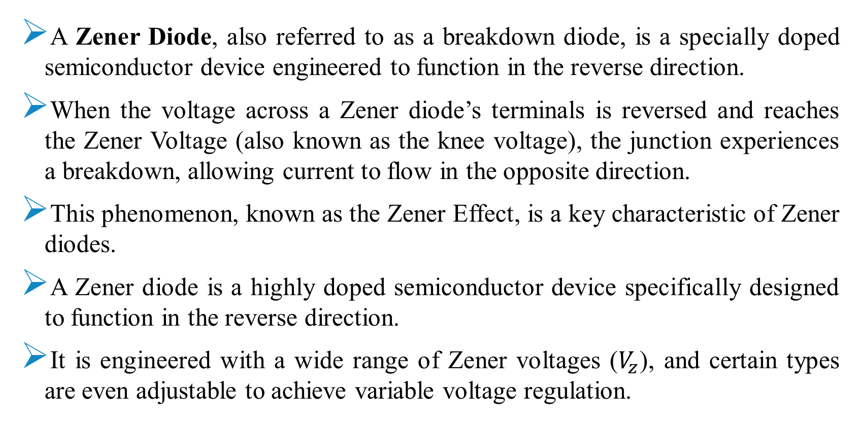
Zener Diode
A Zener Diode, also referred to as a breakdown diode, is a specially doped semiconductor device engineered to function in the reverse direction.
When the voltage across a Zener diode’s terminals is reversed and reaches the Zener Voltage (also known as the knee voltage), the junction experiences a breakdown, allowing current to flow in the opposite direction.
This phenomenon, known as the Zener Effect, is a key characteristic of Zener diodes.
A Zener diode is a highly doped semiconductor device specifically designed to function in the reverse direction.
It is engineered with a wide range of Zener voltages ($V_{z}$), and certain types are even adjustable to achieve variable voltage regulation.

Slide 4
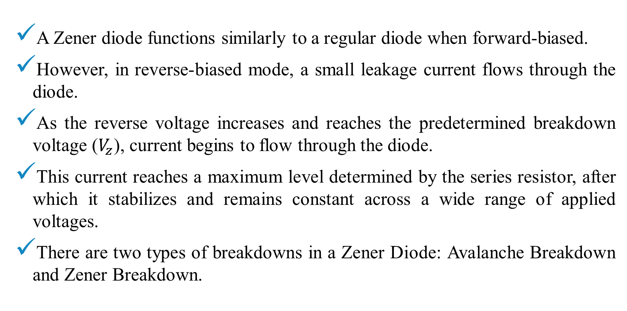
How does a Zener Diode work in reverse bias?
A Zener diode functions similarly to a regular diode when forward-biased.
However, in reverse-biased mode, a small leakage current flows through the diode.
As the reverse voltage increases and reaches the predetermined breakdown voltage ($V_{z}$), current begins to flow through the diode.
This current reaches a maximum level determined by the series resistor, after which it stabilizes and remains constant across a wide range of applied voltages.
There are two types of breakdowns in a Zener Diode: Avalanche Breakdown and Zener Breakdown.

Slide 5
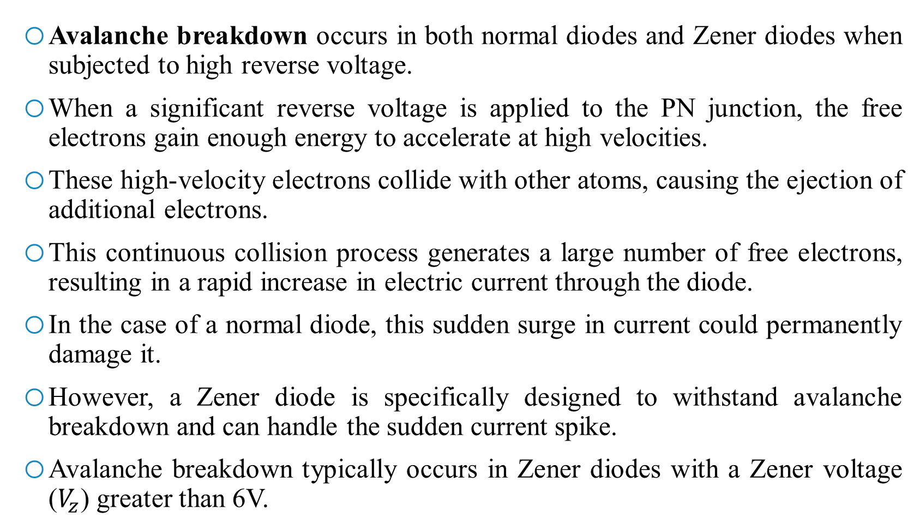
Avalanche Breakdown in Zener Diode
Avalanche breakdown occurs in both normal diodes and Zener diodes when subjected to high reverse voltage.
When a significant reverse voltage is applied to the PN junction, the free electrons gain enough energy to accelerate at high velocities.
These high-velocity electrons collide with other atoms, causing the ejection of additional electrons.
This continuous collision process generates a large number of free electrons, resulting in a rapid increase in electric current through the diode.
In the case of a normal diode, this sudden surge in current could permanently damage it.
However, a Zener diode is specifically designed to withstand avalanche breakdown and can handle the sudden current spike.
Avalanche breakdown typically occurs in Zener diodes with a Zener voltage ($V_{z}$) greater than 6V.

Slide 6
Zener Breakdown in Zener Diode
When the reverse bias voltage applied to a Zener diode approaches its Zener voltage, the electric field within the depletion region becomes strong enough to attract and remove electrons from their valence band.
These valence electrons, energized by the intense electric field, break free from their parent atoms.
This phenomenon takes place in the Zener breakdown region, where even a slight increase in voltage leads to a rapid surge in electric current.

Slide 7
Avalanche Breakdown vs. Zener Breakdown
The Zener effect is predominant in voltages up to 5.6 volts, while the avalanche effect becomes more prominent beyond that threshold.
Although both effects are similar, the distinction lies in the fact that the Zener effect is a quantum phenomenon, whereas the avalanche effect involves the movement of electrons in the valence band, similar to an electric current.
The avalanche effect allows a larger current through the diode compared to what a Zener breakdown would permit.

Slide 8
Circuit Symbol of Zener Diode
Zener diodes come in various packaging options, depending on their power dissipation requirements.
Some are designed for high-power applications, while others are available in surface mount formats.
The most commonly used Zener diode is packaged in a small glass enclosure, with a distinctive band indicating the cathode side of the diode.
The symbol used to represent a Zener diode in circuit diagrams is similar to that of a regular diode, but with a unique addition.
It consists of a triangle or arrowhead pointing towards the cathode side (the side with the band) of the diode.
This triangle is accompanied by two perpendicular lines at the cathode end, one extending upwards and the other extending downwards.
These lines indicate the specific behaviour of the Zener diode and help distinguish it from other types of diodes in circuit diagrams.
The symbol provides a visual representation that allows engineers and technicians to easily identify and understand the presence of a Zener diode in a circuit.

Slide 9
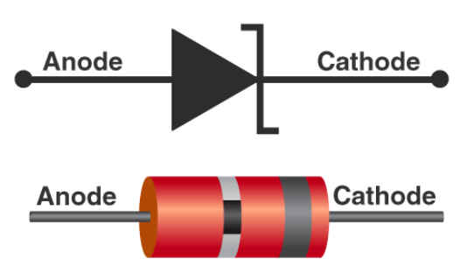
Circuit Symbol of Zener Diode
Fig. 1: Zener diode symbol and package outlines.

Slide 10
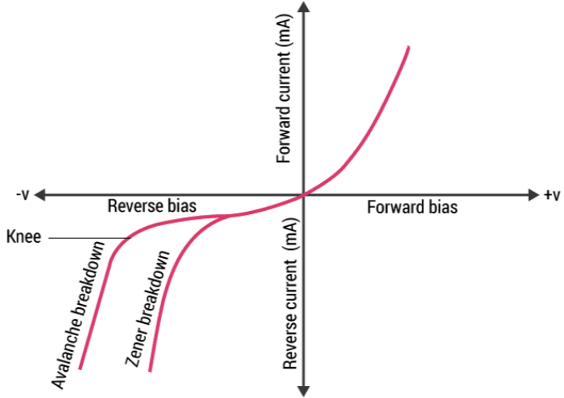
V-I Characteristics of Zener Diode
The diagram in Fig. 2 shows the V-I characteristics of the Zener diode.
The V-I characteristics of a Zener diode can be divided into two parts as follows:
(i) Forward Characteristics
(ii) Reverse Characteristics
When reverse-biased voltage is applied to a Zener diode, it allows only a small amount of leakage current until the voltage is less than the Zener voltage.
Fig. 2: V-I characteristics curve of Zener diode.

Slide 11
Forward Characteristics of Zener Diode
The first quadrant in the graph represents the forward characteristics of a Zener diode.
From the graph, we understand that it is almost identical to the forward characteristics of P-N junction diode.

Slide 12
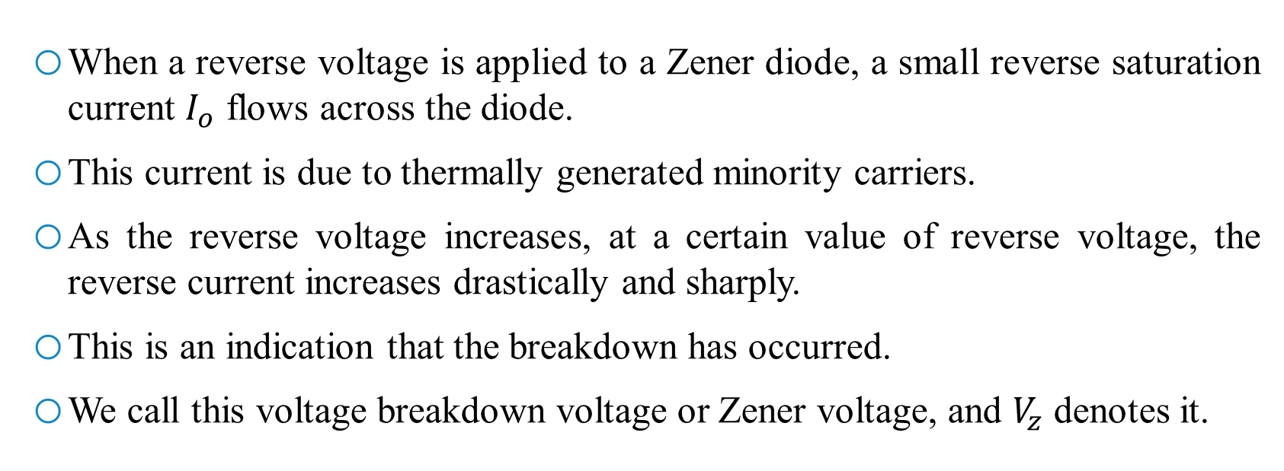
Reverse Characteristics of Zener Diode
When a reverse voltage is applied to a Zener diode, a small reverse saturation current $I_{o}$ flows across the diode.
This current is due to thermally generated minority carriers.
As the reverse voltage increases, at a certain value of reverse voltage, the reverse current increases drastically and sharply.
This is an indication that the breakdown has occurred.
We call this voltage breakdown voltage or Zener voltage, and $V_{z}$ denotes it.

Slide 13
Applications of Zener Diode
Voltage Regulation.
Overvoltage Protection.
Wave Shaping & Clipping Circuits.
Reference Voltage Generation.
Meter Protection Circuits.
Switching Applications.

Slide 14
Reference Books
Electronic Devices and Circuit Theory: Robert L. Boylestad and Louis Nashelsky.
Electronic Principles: Albert P. Malvino.
Micro Electronics Circuits: Adel S. Sedra & Keneth C. Smith: Oxford University Press.
Operational Amplifiers and Linear Integrated Circuits: Robert F. Coughlin: Prentice Hall of India Private Limited.

Slide 15


